Slide 1

QEHS DEPARTMENT INSPECTION REPORT
SONIA FOOD INDUSTRIES LTD FACILITY INSPECTION
OCTOBER 8TH, 2025

Slide 2
Introduction

Slide 3
Executive Summary
Report Year: 2025
📊 Total Trainings: 1090
👥 Total Staff (All): 8423
✅ Active Staff: 7293
📚 Staff Trained (Active): 841
🏪 Stores Trained: 313
⏰ Pending Trainings: 6452

Slide 4
Training Frequency
Training Title | Times Held | Date Range
Food Safety | 306 | 2025-02-13 to 2025-09-30
Occupational Health And Safety | 224 | 2025-02-05 to 2025-10-23
First Aid | 201 | 2025-02-04 to 2025-10-15
Pest Control | 127 | 2025-02-18 to 2025-09-18
Fires Safety | 108 | 2025-01-30 to 2025-09-09
Water Treatment | 99 | 2025-02-19 to 2025-04-29
Food Handlers Workshop | 11 | 2025-03-21 to 2025-03-21
Frozen Pie Handling And Baking Process | 9 | 2025-06-16 to 2025-06-16
Energy Conservation | 3 | 2025-06-16 to 2025-06-16
Preventive Maintenance Workshop | 1 | 2025-06-16 to 2025-06-16
Effective Restaurant Management Workshop | 1 | 2025-06-16 to 2025-06-16

Slide 5
STORES TRAINING COVERAGE
Total Stores: 612

Slide 6
STAFF PARTICIPATION ANALYSIS
Total Eligible Staff: 7293
Participated: 841
Not Participated: 6452

Slide 7
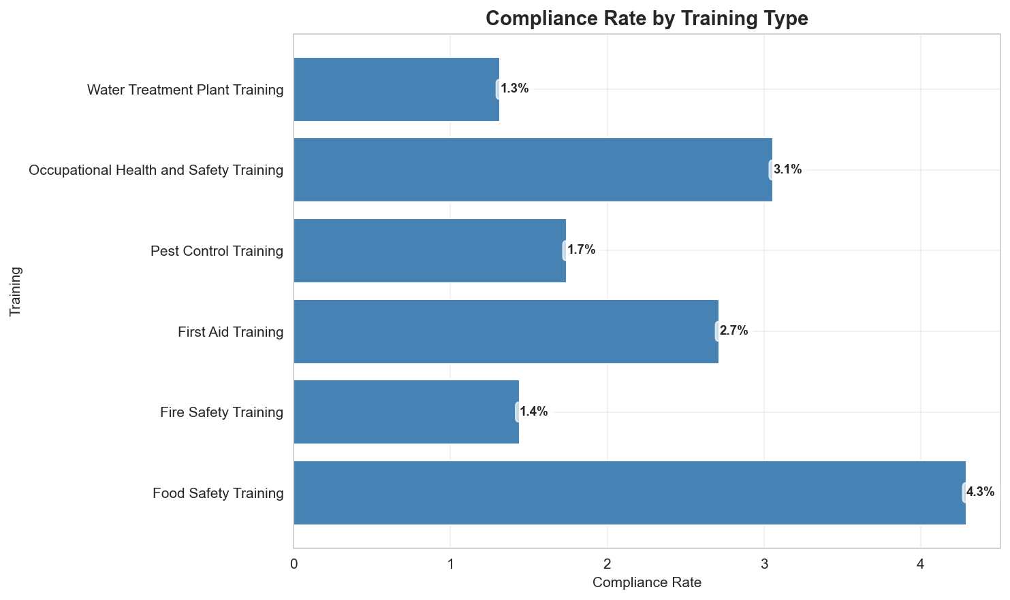
COMPLIANCE DASHBOARD - ALL REQUIRED TRAININGS

Slide 8
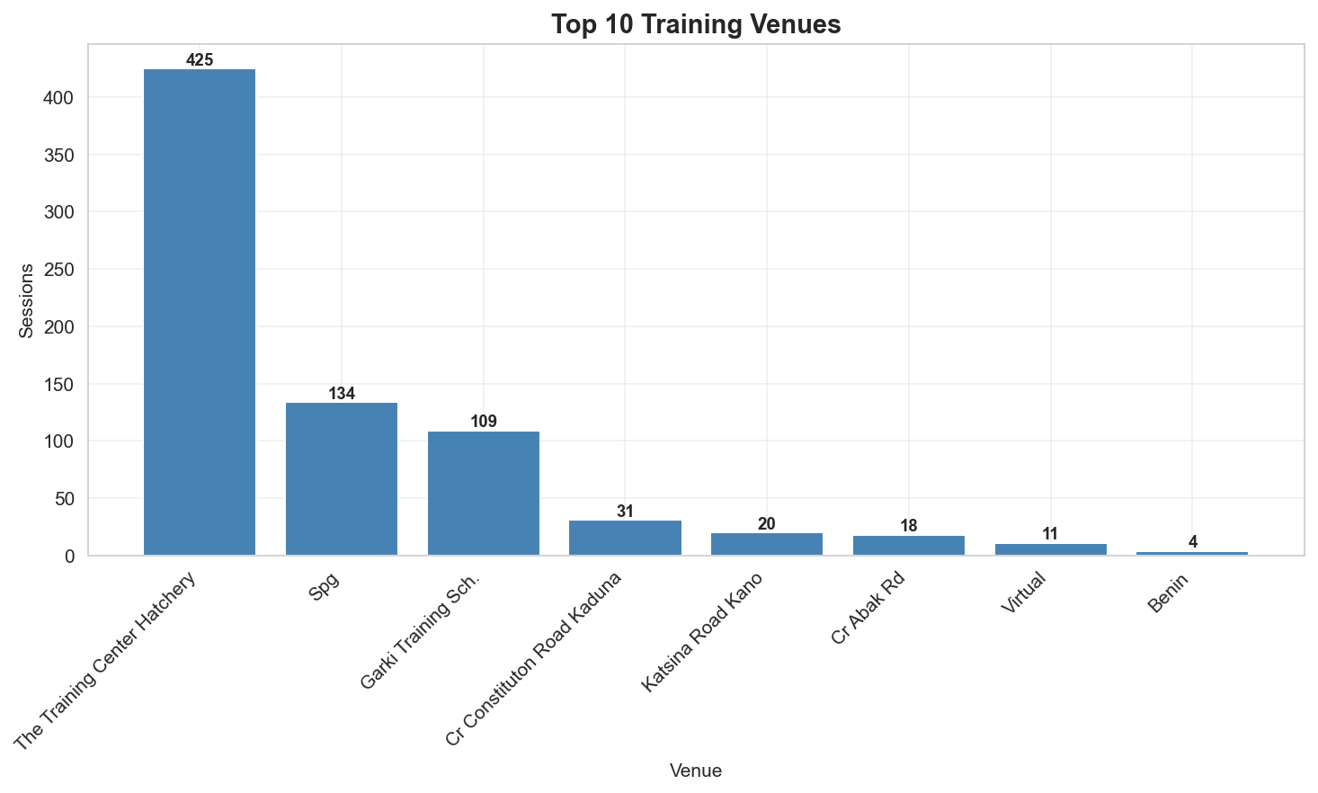
TRAINING BY VENUE

Slide 9
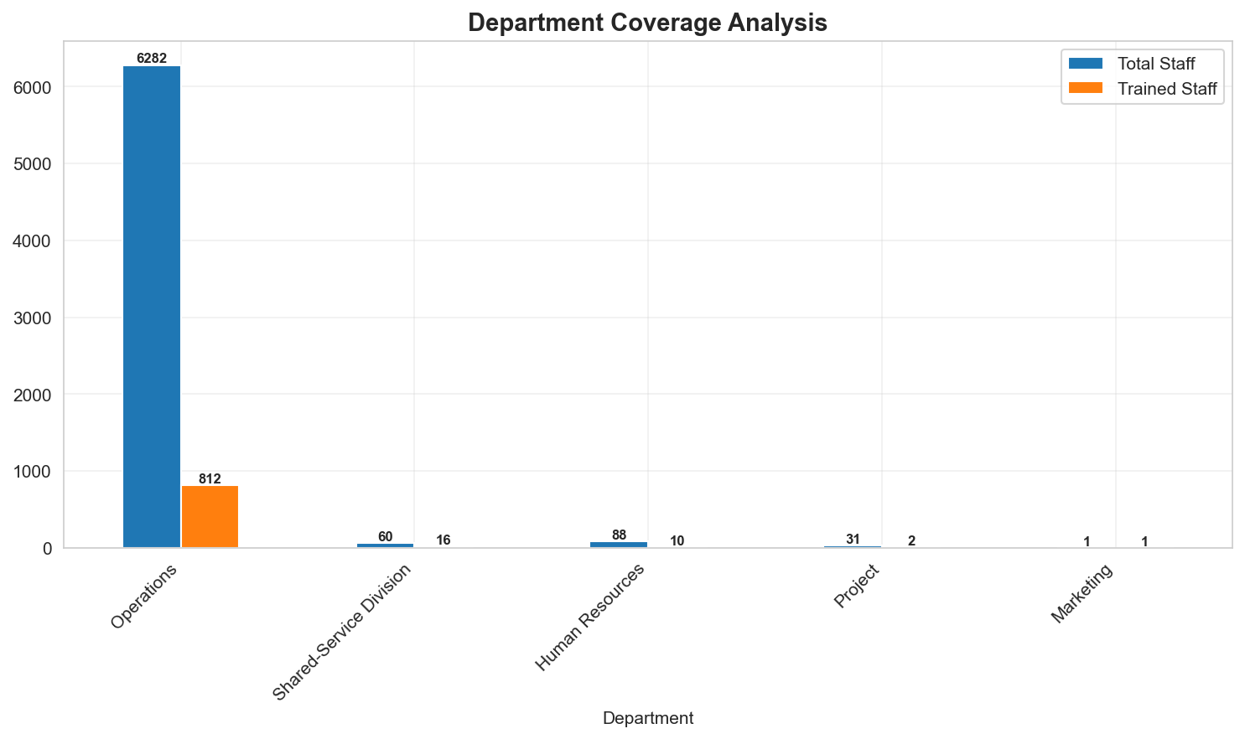
TRAINING COVERAGE BY DEPARTMENT

Slide 10
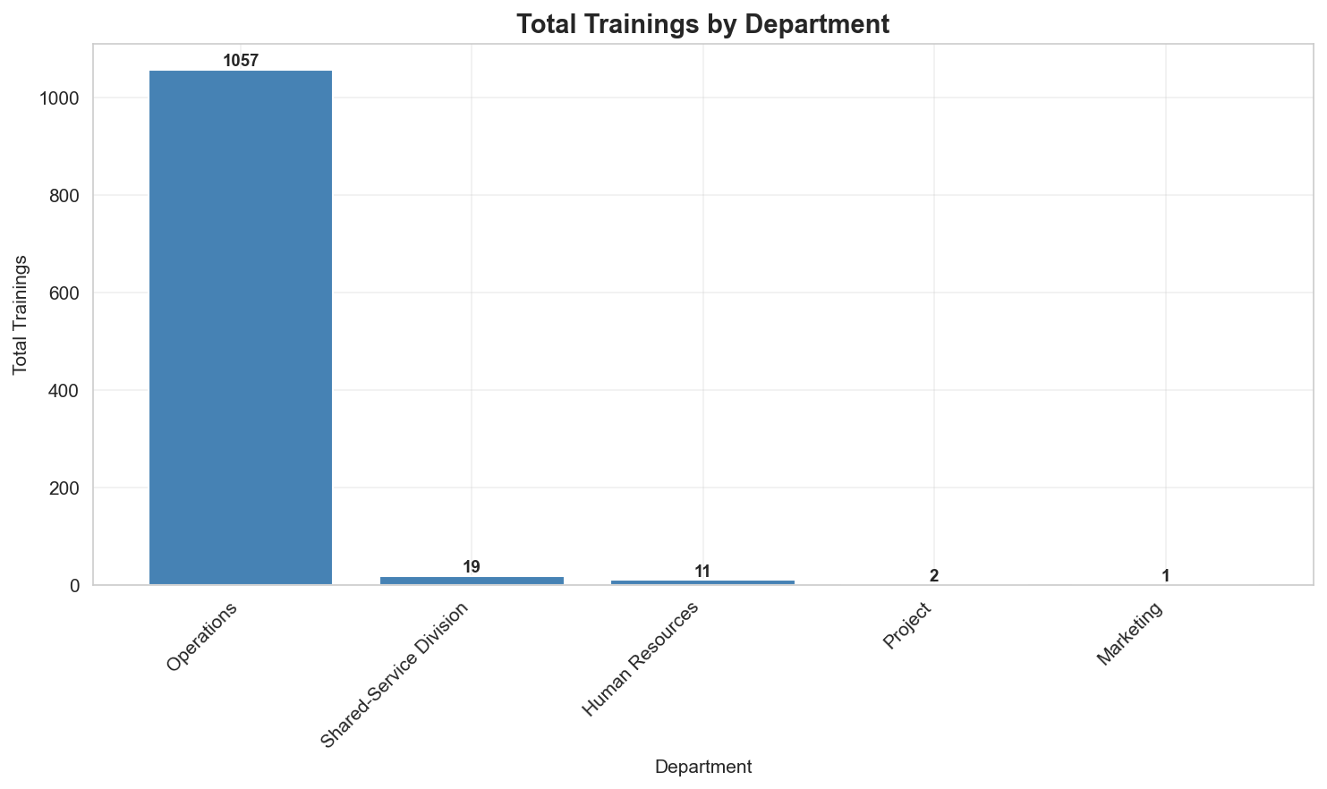
TRAININGS BY DEPARTMENT

Slide 11
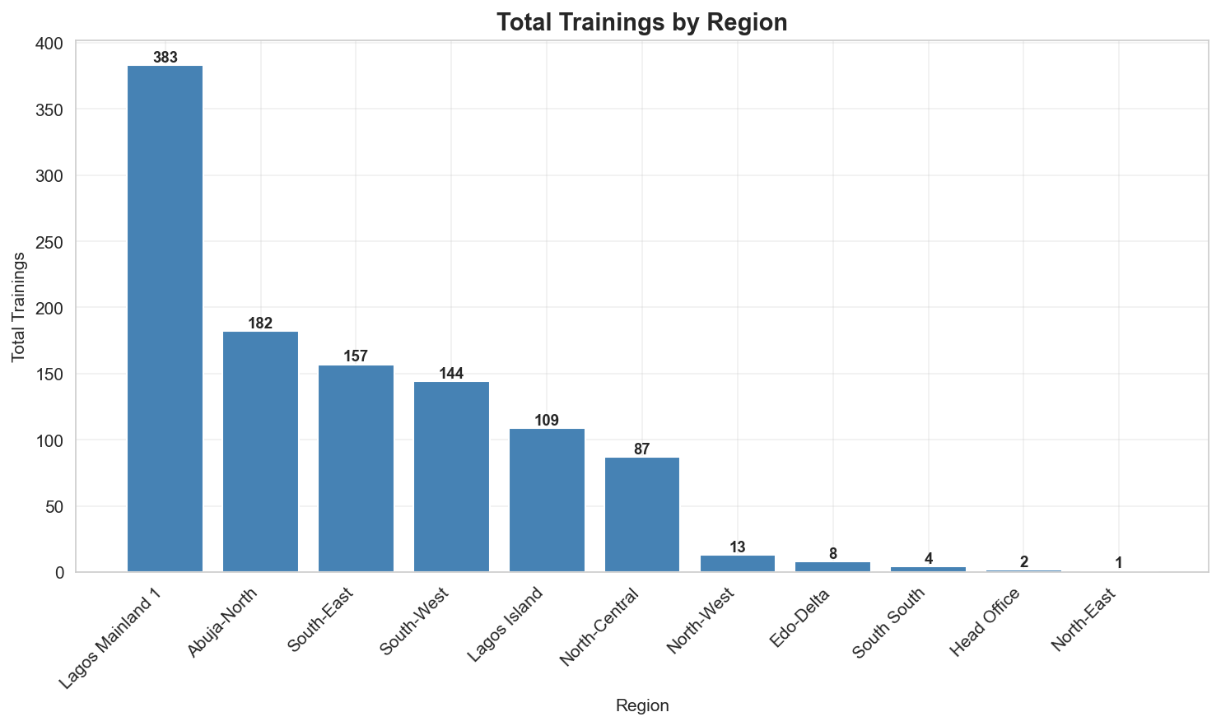
TRAININGS BY REGION

Slide 12
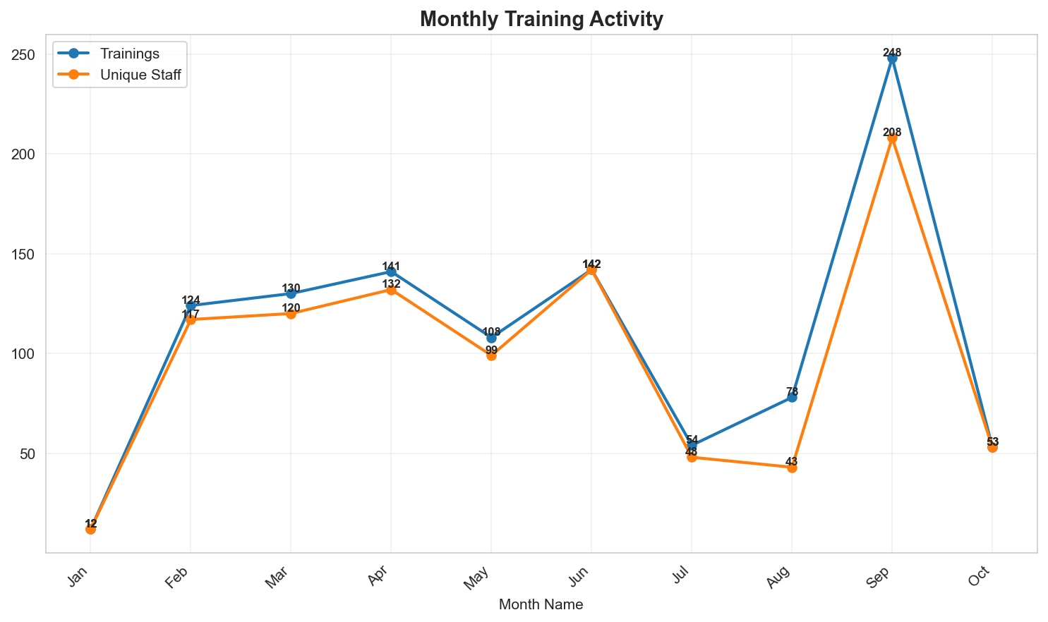
MONTHLY TRAINING TRENDS (2025)

Slide 13
STAFF YET TO BE TRAINED

Slide 14
THANK YOU

